Slide 1
II Corinthians: Brief Outline
Salutation And Thanksgiving (1:1-11)
Paul Explains His Ministry Of Reconciliation (1:12-7:16)
He Defends His Integrity (1:12-2:11)
He Describes His Apostolic Ministry (2:12-6:10)
He Makes His Appeal To Them (6:11-7:16)
The Collection For The Saints In Jerusalem (8:1-9:15)
Paul Defends His Apostolic Authority (10:1-13:10)
Concluding Exhortations And Benediction (13:11-14)
Executable Outlines, Copyright © Mark A. Copeland, 2011

Slide 2
II Corinthians 1:1-11
Thanksgiving for deliverance in Asia – 1:8-11
To what sufferings might he be referring?
Difficulties in Ephesus; I Cor 16:8-9, Acts 19:23-41
How serious was it?
Despaired for life, had the sentence of death within themselves
Trusted not in themselves but in God who raises the dead
What had worked together for Paul’s deliverance?
God delivered them (vs 9-10)
Prayers of the Corinthians and others (vs 11)
How strong was Paul’s confidence in God? (v10)
Paul had set his hope on God…What hope is he referring?
Confident God would ultimately deliver (Dan 3:16-18)
What lessons should we take away?
Always trust in God to deliver us no matter how bad the situation may be
God listens to our prayers for ourselves and each other
Prayer is a powerful source of comfort

Slide 3
II Corinthians: Brief Outline
Salutation And Thanksgiving (1:1-11)
Paul Explains His Ministry Of Reconciliation (1:12-7:16)
He Defends His Integrity (1:12-2:11)
He Describes His Apostolic Ministry (2:12-6:10)
He Makes His Appeal To Them (6:11-7:16)
The Collection For The Saints In Jerusalem (8:1-9:15)
Paul Defends His Apostolic Authority (10:1-13:10)
Concluding Exhortations And Benediction (13:11-14)
Executable Outlines, Copyright © Mark A. Copeland, 2011

Slide 4
II Corinthians 1:12-2:11 Paul Defends His Integrity
In what did Paul “boast” or have “proud confidence”? (12-14)
The testimony of their conscience; to what is this referring?
How they had conducted themselves in the world and especially towards the Corinthians -- how had they conducted themselves?
In holiness and godly sincerity; in the grace of God
Not in fleshly wisdom
Had Paul acted any differently in his writings to them?
No; and they knew that to be the case
They were each other’s reason for being “proud” in the day of the Lord
How so?
What are Paul’s points?
He knows that he has conducted himself properly towards them
Never given them a reason to doubt him; they know this to be the case
This conduct and their work together for the Lord has earned a level of trust
Don’t let self-serving people cause them to lose this trust

Slide 5
II Corinthians 1:12-2:11 Paul Defends His Integrity
Paul addresses doubts raised concerning his seriousness in coming to them

Slide 6
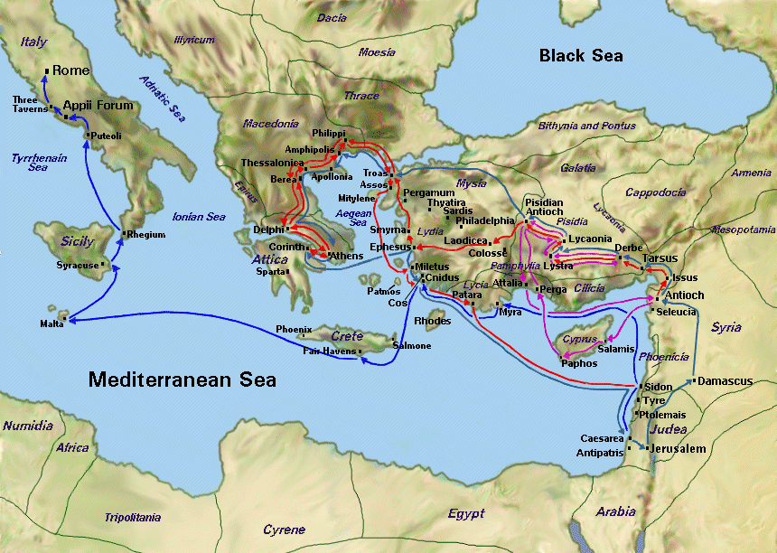
Actual Trip – Acts 20:1-3
Made it as far as Greece
Does not go to Achaia
Paul’s Plan – Acts 19:21
Return to Jerusalem after passing through Macedonia and Achaia (I Cor 16:5-7)
Paul at Corinth- Acts 18
Second Journey
There at least 1 ½ years
Departs for Jerusalem; passes through Ephesus -- leaves Aquila and Priscilla there
Paul at Ephesus – Acts 19
Third Journey
There at least 2 years
Writes I Corinthians
Apollos– Acts 18:24-19:1
Arrives at Ephesus
Taught Word more accurately
Goes to Corinth
First Missionary Journey (A.D. 46-48)
Second Missionary Journey (A.D. 49-52)
Third Missionary Journey (A.D. 53-57)
Trip to Rome (A.D. 59-60)

Slide 7
II Corinthians 1:12-2:11 Paul Defends His Integrity
Paul addresses doubts raised concerning his seriousness in coming to them
He told them his intent in previous letter; I Cor 16:5-7 (Acts 19:20-21)
This was always his intent (vs 15-16)
But he changes his mind
They should know this was his intent based on their established trust (vs 17)
Paul professes his word to be faithful in what things? (vs 18-20)
As God is faithful
The trustworthiness of the promises of God as preached to them
What important points does Paul attribute to God to reinforce this trustworthiness? (vs 21-22)
God established Paul with them in Christ
God anointed them
God sealed them
God gave them the Spirit in their hearts as a pledge

Slide 8
II Corinthians 1:12-2:11 Paul Defends His Integrity
What reason does Paul give for not coming to Corinth (vs 23)
To spare them -- spare them from what?
More sorrow
Condemnation in person
To give them time to change their course
What is Paul’s point in verse 24?
Not that we lord it over your faith
Workers with you for your joy
You are standing firm in your faith / It is by faith that you stand firm
Even as an apostle, he could not dictate their faith; they had to make that choice
Rather, he and his companions were instruments help build their faith which would increase their spiritual joy
Ultimately, they stand based on their own faith

Slide 9
II Corinthians 1:12-2:11 Paul Defends His Integrity
What had Paul determined for his own sake (2:1-2)
To not come to them in sorrow again; why?
Who would make him glad but those who he made sorrowful
Paul’s thoughts and motives behind the first letter (3-4)
Why did he write what he wrote to them?
To help them see their wrongs so they could change (3)
After their change, he could come and they could rejoice together
Him rejoicing in knowing his letter was affective; they rejoicing in being spiritually restored
That they could see the love he had for them (4)
Was this an easy thing for him to do? (4)
No; much affliction and anguish of heart with many tears
How does this apply to us?
Not easy going to brothers and sisters that need correction
But out of love and concern we do what has to be done
Hopeful that we can rejoice together in their repentance

Slide 10
II Corinthians 1:12-2:11 Paul Defends His Integrity
Restoration of the immoral brother (5-11)
Why does Paul talk about this at this point in the letter?
Help them better see his previous points
To whom had he caused sorrow? Just Paul?
To his brothers and sisters to some extent; how so?
What were Paul’s follow-on instructions?
The punishment inflicted by the majority was sufficient
Apparently, not everyone followed Paul’s original instructions
Yet, enough did to get the point across and help him to repent
Forgive and comfort him; why?
Lest he be overwhelmed with excessive sorrow
Reaffirm their love for him
How do these instructions relate to Paul’s message on the sorrow they had caused him?
They felt the sorrow caused by the immoral brother
Paul is using this to help them see the sorrow they caused him
The follow-on instructions should help them the overarching reason their actions to the brother and Paul’s actions toward them -- LOVE

Slide 11
II Corinthians 1:12-2:11 Paul Defends His Integrity
Restoration of the immoral brother (5-11)
Why had Paul wrote concerning this brother? (9)
To put them to the test; to see if they would be obedient in all things
Why would this be “a test”?
The difficulty in taking action against a brother
Was there any further action for Paul to take? (10-11)
No; they had followed his directions and taken the proper actions
As they could forgive and rejoice with the brother, Paul could forgive and rejoice with them
Why were these actions important?
To not give Satan any advantage; how so?
Sin had been exposed and properly dealt with
Forgive, restore and reaffirm love so the family can be united and move forward in its spiritual growth

Slide 12
II Corinthians: Brief Outline
Salutation And Thanksgiving (1:1-11)
Paul Explains His Ministry Of Reconciliation (1:12-7:16)
He Defends His Integrity (1:12-2:11)
He Describes His Apostolic Ministry (2:12-6:10)
He Makes His Appeal To Them (6:11-7:16)
The Collection For The Saints In Jerusalem (8:1-9:15)
Paul Defends His Apostolic Authority (10:1-13:10)
Concluding Exhortations And Benediction (13:11-14)
Executable Outlines, Copyright © Mark A. Copeland, 2011

Slide 13
II Corinthians 2:12-6:10 Paul Describes His Apostolic Ministry
Closing thought before transitioning to the motivation of his ministry (12-13)
Had just talked to them about what should be their motivation -- their faith:
The importance of having their own faith (1:23-24)
Him providing time for them to make their choices concerning their faith (2:1-4)
The application of that faith in regards to the immoral brother and the challenges/internal conflicts that presented (2:5-11)
Touches on his challenges/conflicts
Excited about the “open door” presented at Troas (12)
Anxious for news about them; moves on to Macedonia (13)

Slide 14
II Corinthians 2:12-6:10 Paul Describes His Apostolic Ministry
Paul introduces the motivation of his ministry (14)
What two specific things does Paul mention related to his motivation?
Thanks to God and trust that He will always lead them to triumph in Christ
Use them to manifest the sweet aroma of knowledge of Him everywhere
Paul expands on Christians being the sweet aroma of knowledge (15-17)
To whom are Christians a fragrance of Christ?
Those being saved
Those who are perishing
How are we viewed by each?
Aroma from death to death
Aroma from life to life
What does Paul say is key for being able to meet this standard?
Speaking before God with sincerity like men sent from God
Not peddling the word for God; apparently for selfish purposes

